Slide 1

Programming: Selection Control
Robert Doe
AUTHOR, TRAINER AND PROUD DEVELOPER
@bobcumulus www.codeden.org

Slide 2
Selection Control Structure
“The selection control structure allows one set of statements to be executed if a condition is true and another set of actions to be executed if a condition is false

Slide 3
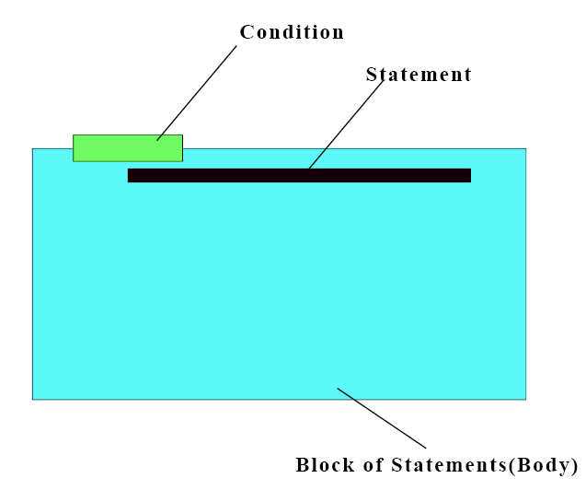
Structure of Conditional Statement

Slide 4
Syntax
IF (CONDITION)
Statements(s)
END IF

Slide 5
Structure of Conditional Statement
TRUE
DO ME

Slide 6
Structure of Conditional Statement
FALSE
DO ME

Slide 7
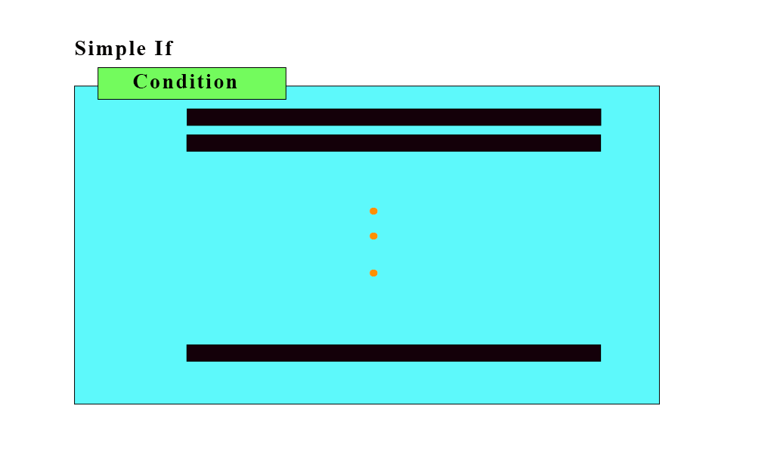
Simple If

Slide 8
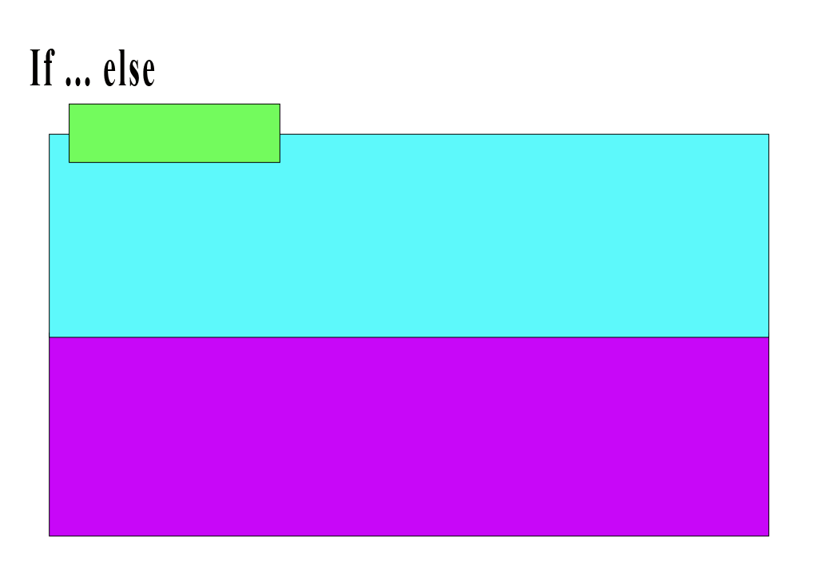
If … Else

Slide 9
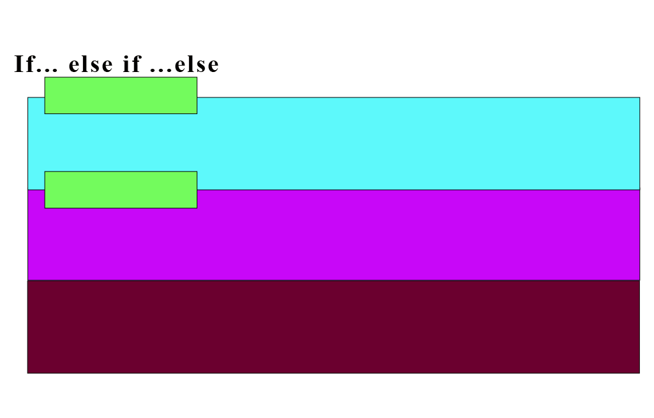
Multi If/Cascaded If

Slide 10
Illustration
IF it rains today, I’ll buy you a car
IF student is male, Give him a pair of trousers
ELSE give her a skirt
IF baby is a girl, We’ll call her Linda
ELSE IF baby is a boy, We’ll him Tom
IF age is between 0 and 9, Group under KID
ELSE IF age is between 10 and 17, Group under ADOLESCENT
ELSE IF age is between 18 and 59, Group under ADULT
ELSE Group under AGED

